Slide 1
MTSS Maryland: Shift Happens Creating Positive Conditions for Learning through Coordinated Multi-Tiered Systems of Support
Maryland State Department of Education
Title I Administrative Meeting Spring 2015
Sheppard Pratt Health System
Johns Hopkins Bloomberg School of Public Health
University of Maryland,
Center for School Mental Health
Division of Student, Family, and School Support,
Division of Special Education/ Early Intervention Services
Division of Early Childhood Development

Slide 2
PRESENTATION OF
MTSS MARYLAND
Kristina Kyles,
Assistant State Superintendent
Division of Student, Family and School Support
Maryland State Department of Education
200 West Baltimore Street, Baltimore MD 21201
Phone:410-767-0274 Fax: 410-333-8148
Kristina.kyles@maryland.gov
Notes:
Greetings
Acknowledge response forms
I have had the pleasure of meeting most of you all. However, in case I have not, let me say hello and thank you all for joining. As I have been saying at all of our convenings, my team and I have been tasked by the BOE to work on a plan to scale up PBIS and by this increase your access to tools and resources that will aid you in increasing the effectiveness of your school’s culture and climates.
I want to thank you all particularly because I know that you all have in the midst of annual state testing…

Slide 3
Purpose of the Discussion
Update on the strategic shift of the Division of Student, Family, and School Support (DOSFSS) for PBIS Maryland.
Give stakeholders the opportunity to provide feedback to the MTSS Maryland Report to the State Board of Education

Slide 4
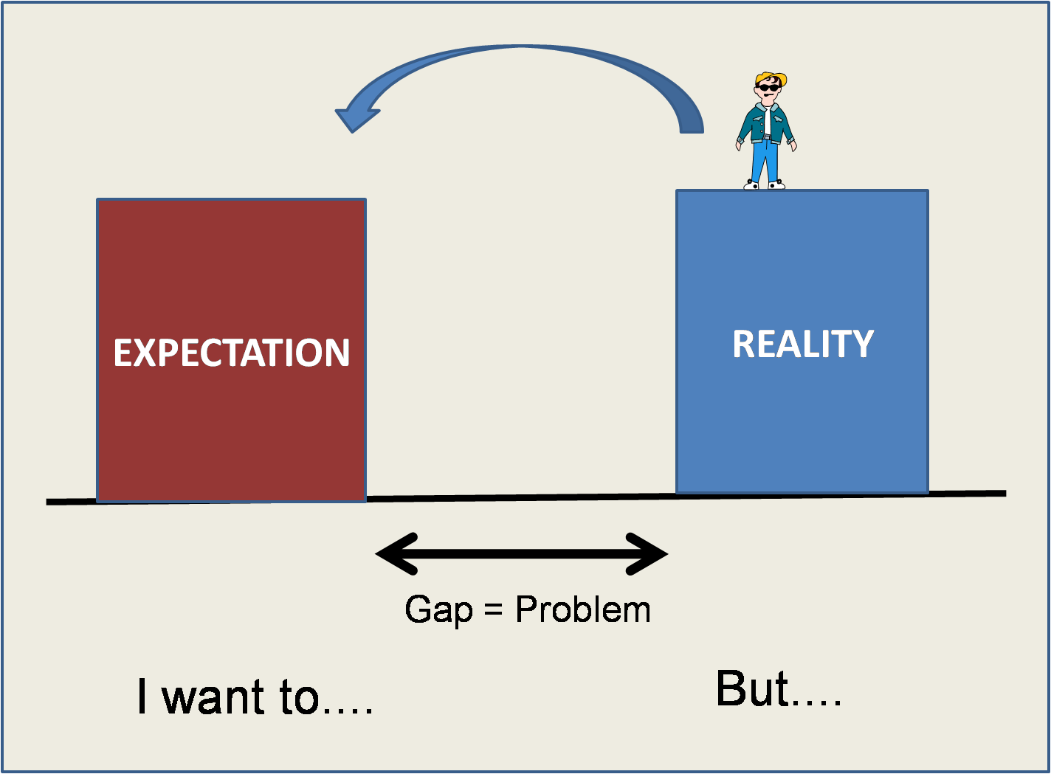
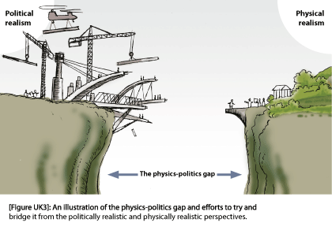
WHY?
Why?
Career and College Readiness
All Students
Birth to 21
ACHIEVEMENT GAP
SUPPORT SYSTEM GAP
Standards for Learning
Academic
Social
Emotional
Varied Skills & Abilities
Academic
Social
Emotional
Notes:
PURPOSE WHY MTSS?
There are two gaps schools need to close in order to better ensure students can be successful.
The first is an achievement gap. This is notable in all our data and shows that different subgroups perform better or worse on tasks. This is often a measure of students performing with varied skills and abilities.
Secondly, there is a resource gap. That some students are not able to get all that they need to develop their academic or social skills and this hinders their performance or the acquisition of necessary skills and abilities.
We believe that if we better structure an intentional system of support, we will be able to better align resources that will impact a student ability to achieve. Therefore, we would like to be a change agent, ensuring that we can provide students a more streamlined access to resources within our reach and better neutralize the ability to develop or acquire the necessary skills to succeed in school.
Maryland has been leaders in implementing programs that aim to support students, provide targeted resources to schools and close the achievement gap. Many efforts around academic achievement fall into buckets that are “silo-ed” resulting in a support system gap.
DOSFSS will lead the way in aligning the support system that will impact by collaborating and integrating our work.
We expect that a coordinated multi-tiered system of support is crucial to the work of others in closing the achievement gap.

Slide 5
ALIGNING POLICIES
IDEA
Individuals with Disabilities Education Act
ESEA
Elementary and Secondary Education Act:
DISPRO
DISPROPORTIONALITY
BRIDGE TO EXCELLENCE
BTE
CSS
COORDINATED STUDENT SERVICES
THE GUIDELINES
CODE OF CONDUCT
ACCESS & EQUITY
PBIS

Slide 6
Student Reality & Being On Track to Graduation
On Track Behaviors
Off Track Behaviors
Disengaged
Lack of Self-Control
Drop Out
Poor Attendance
Lack of Skills
Cognitive Skills & Attitudes
Academic Achievement
Positive Educational Engagement
Grades, Scores, and Graduation
Attendance, behavior, and completion
Concentration, memory, mood & Motivation
Notes:
Capacity and skills tip the scales for today’s students to be either in favor of on track or off track behaviors. All behavior have a function and serves a purpose, our goal is to make sure that more often than not, the behaviors displayed in schools serve the function of propelling students towards being college and career ready. Today’s youth have complex needs and live in an increasingly complex world. Sometimes, our students live in worlds that we nor our teachers could ever imagine. Students today need supports more than ever to connect to each other, to school, and to their full potential. These connections make all the difference in igniting those on track behaviors and those behaviors that help students unlock their full potential.
In creating this report, let me run through some our fundamental beliefs and assumptions

Slide 7
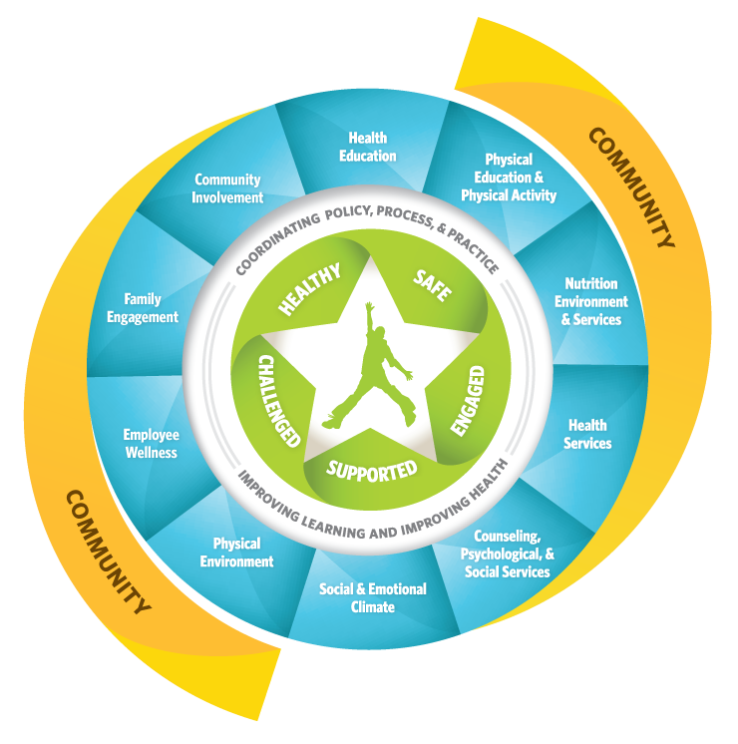
Whole School
Whole
Community
Whole Child
ASCD:
Collaborative Approach to
Learning and Health
Notes:
For the purposes of this presentation, academic achievement is defined as…
Academic Performance (grades, scores and graduation)
Education Behavior (Attendance, Retention, Behavior and positive engagement w/o exclusion)
Responds to the call for greater alignment, integration, and collaboration between health and education to improve each child’s cognitive, physical, social and emotional development.

Slide 8
MTSS: Coordinated 3-Tiered Practices
Notes:
This is an example of what a menu of Multi-Tiered Systems of Support might look like.
It is not all inclusive, one of our Divisions first tasks may be to create a comprehensive menu of supports. For example, include physical health and family involvement practices that we are committed to in policy and through professional development, and TA.
This table also demonstrates a way to align our divisions efforts to support positive conditions for learning across the tiers of intervention; for all, some, and few.
Similar tables could be developed within other divisions, partner agencies, and ultimately model coordination of effort for the LSS level.
Sharing multiple practices within the three-tiered system allows coordination systems; a multi-tiered system of support.

Slide 9
Defining the What…

Slide 10
MTSS MARYLAND: GOALS
Goal 1: Expand and Enhance the State and District Level Infrastructure
Objective 1: Prioritize Full Integration and Effective Coordination.
Objective 2: Examine current capacity of trainers and coaches and build expertise at the state, district and school team level.

Slide 11
MTSS MARYLAND: GOALS
Goal 2: Develop an MTSS Evaluation Plan that includes a Data Collection System for Implementation, Evaluation and Promotion of MTSS
Goal 3: Collect, Use, and Report Disaggregated Student Discipline Data
Goal 4: Provide Training and Supports for Administrators in MTSS

Slide 12
MTSS MARYLAND: GOALS
Goal 5: MSDE Staff will serve as MTSS Technical Assistance Experts
Goal 6: Use a multi-tiered approach to deliver intensive and differentiated training and technical assistance
Goal 7: Use the Coordinated Student Services Model to maximize effectiveness of Tier II, III supports.

Slide 13
MTSS MARYLAND: GOALS
Goal 8: Conduct annual reviews of state and local policies to ensure alignment to evidence based practices with emphasis on a proactive, preventative approach.
Goal 9: Improve access and delivery of school based mental health
Goal 10: Increase Student, Family and Community Support through MTSS

Slide 14
2018 Goal
75% of all schools in Maryland trained and implementing Tier I with fidelity;
50% of those implementing Tier II with fidelity; and
25% of those implementing Tier III with fidelity.

Slide 15
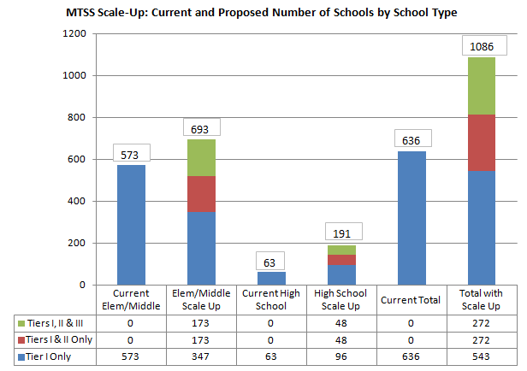

Slide 16
GAPS
Leadership
Overarching Governance Structure to Drive MSDE Goals
State Level Data System and Evaluation
Competency Driver
Assessing Fidelity of Implementation at Tier I
Implementing Tiers II and III with fidelity
Capacity Driver
Regionalized Technical Support
Notes:
Leadership:
Executive and Management leadership teams within MSDE and partner agencies cooperate to support individual grants; however, there is a lack of an overarching governance structure to ensure collaborative efforts and sustainability objectives across grant initiatives. Most importantly, MSDE needs to plan, conduct and produce inter-related, sustainable approaches for conducting Coordinated Student Services.
There are routine reports regarding the number of training sessions conducted and certain participating schools share fidelity and outcome measures, depending on their interest in applying for special recognition or to comply with grant requirements. However, there is a need for a State level evaluation plan to collect a universal set of data in order to assess fidelity, outcomes and the relationship between implementation fidelity and outcomes.
The plan addresses the gaps in leadership by creating a hierarchy of collaborative leadership teams to provide overarching governance for setting goals guiding the work of the competency and capacity drivers.
Competency:
The primary focus on previous training is on schools implementing Tier I supports. Training is delivered through a regionalized process in a whole group format and follow-up coaching is not conducted in a formal way. As a result, fidelity of implementation has been a challenge for many trained schools.
Tiers II and III of the Multi-Tiered Systems of Support Framework for Maryland are still evolving in their development and implementation. Few schools are implementing Tier II, but there is no way to ascertain the fidelity of implementation. Tier III training has not been systematically developed for distribution.
The plan addresses the gaps in selection of practices, training and coaching by building state-level capacity through a Trainer-of-Trainer’s process that will develop the skills needed to support local systems and school staff. A structured coaching model will be implemented to aid local systems in achieving the standard for fidelity of implementation.
Capacity:
Currently, technical support is delivered primarily to those school teams implementing PBIS and that technical support is not always coordinated or aligned with state other state initiatives and programs. This results in multiple messages being provided to schools about the delivery of supports to student struggling with academic and behavioral concerns and does not address the needs of schools implementing programs other than PBIS.
There are too few technical support providers in the state to adequately meet the needs and challenges of school teams implementing behavioral and academic programming for students. This contributes to the challenges with fidelity of implementation and consistent outcomes.
The plan addresses the gaps in technical support through the development of regionalized technical support “collaboratives” that are designed to strategically target and identify the needs of school teams and staff. A secondary role of these regionalized technical support “collaboratives” will be to align state-level efforts in order to deliver coordinated support.

Slide 17
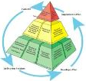
DOSFSS will support and strengthen Tier I
DOSFSS will expand and develop Tier II and III
DOSFSS will engage other Divisions and Partner Agencies
HOW?
Sustain
Align
Scale Up
Notes:
What will DOSFSS do to coordinate multi-tiered systems of support?
Align DOSFSS initiatives with other Divisions and Partner school support initiatives through a three-tiered framework
Sustain current universal school support efforts to fidelity (Tier I)
Scale Up menu of targeted (Tier II) and intensive (Tier III) school support efforts

Slide 18
WHY?
MSDE EFFORTS:
Vision
Coordinating the vision of MSDE Divisions
Management Coordination
Integrated Systems of Support
Facilitative Administration
Leveraging Department Expertise
Career and College Readiness
Standards for Learning
Academic
Social
Emotional
Notes:
What divisions at MSDE care about school and student supports and why?
DOSFSS
DSE/EIS
DECD
What work is currently underway separately?
What shared work is currently underway?

Slide 19
PARTNER EFFORTS:
Coaching
Organizational Structure
Selection
Integrated Systems of Support
Training
Leveraging Agency Expertise
All Students
Birth to 21
Varied Skills & Abilities
Academic
Social
Emotional
Notes:
What other organizations care about school and student supports and why?
SPHS
JHU
DHMH
U of MD
What work is currently underway separately?
What shared work is currently underway?

Slide 20
LOCAL SCHOOL SYSTEM EFFORTS:
Decision Supports & Data Systems
Information & Resources
Incentives
All Students
Birth to 21
Varied Skills & Abilities
Academic
Social
Emotional

Slide 21
NEXT | Description of 4-year Implementation Plan
Installation 2015-16 | Management level set up infrastructure to support successful implementation of coordinated multi-tiered systems of support. Establish team and data systems, conduct audit of separate and shared work. Identify gaps in coordination and develop plan.
Initial Implementation 2016-17 | Try out plan with current partners, work out the details, learn and improve before expanding to other contexts.
Elaboration 2017-18 | Expand program/practices to other contexts, and apply lessons learned.
Continuous Improvement/ Regeneration | Ongoing evaluation for efficiency of coordinated systems, effectiveness of multi-tiered practices, and excellence in improving student outcomes.
Notes:
This is a STATE level plan to INTEGRATE service to the local school systems by coordinating our work at the state level to carry out the policies of the BOE, provide professional development and technical assistance to LSS.

Slide 22
“Town Hall Meeting”
Response from Title I Coordinators
How does this plan align with your current work?
Are there gaps in your systems of support that can be met by this plan?
What professional development and technical assistance would you like to see MSDE provide?
Notes:
Order of business for today
15 minute presentation
45 minute Response; 15 minutes per section

