Slide 1
Every Student Succeeds Act (ESSA)
Stakeholder Input
Title I Administrative Meeting: May 19, 2016

Slide 2
Objectives
Compare the Elementary Secondary Education Act (ESEA)/No Child Left Behind (NCLB) and ESSA
Identify the most substantive changes
Preview what Maryland is doing to prepare for the transition and the new law
Gather input for Maryland’s plan to implement the new law

Slide 3
Timeline and Implementation for ESSA
Elementary and Secondary Education Act (ESEA) 1965
No Child Left Behind (NCLB) 2001
ESSA was signed into law on December 10, 2015
Current ESEA waivers expire August 1, 2016
School year 2016-2017 is a transition year
New ESSA provisions go into effect for the 2017-2018 school year
Federal Fiscal Year (FFY) 2016 competitive and formula funding will flow through ESEA construct for school year 2016-2017; FFY 2017 dollars will flow through ESSA construct (in schools for 2017-2018 school year)

Slide 4
What is in ESSA?
Significant improvement over current law
Maintains federal role, but emphasizes that this role is to support/strengthen, not to dictate/prescribe
Returns pendulum of federal overreach and prescription back to states and locals

Slide 5
Substantive Changes
Federal v. State and Local Control in ESSA
Federal
Testing Schedule
Identification of Low-Performing Schools
State and Local
Standards
Assessment Options
Interventions and Support
Accountability Goals
English Learners (ELs)

Slide 6
Standards
NCLB/ESEA Flex | ESSA
Academic content standards in ELA, Math, and Science
Flex required States to adopt college and career-ready standards that are common to a significant number of States or the State had to adopt college and career-ready standards that have been approved and certified by a State network of institutions of higher education (IHE). | “Challenging State Academic Standards” aligned with State’s higher education requirements for credit-bearing coursework and state career and technology standards.

Slide 7
Assessments
NCLB/ESEA Flex | ESSA
Must test in 3-8 and once in High School (HS) in ELA and Math Must test once in each grade band (3-5, 6-8, and HS) in Science
Everyone must use the same assessment in each grade level | Local Education Agency (LEA) can use nationally recognized tests at the high school level with State approval
States are required to meet 95 percent participation and all non-test takers are counted as basic | States are still required to meet a 95 percent participation rate, but State determines consequences for not meeting 95 percent for LEAs/schools
 | Innovative Assessment Pilot

Slide 8
Accountability
NCLB/ESEA Flex | ESSA
States were bound to Adequate Yearly Progress (AYP) with Annual Measurable Objectives (AMOs) to meet 100 percent proficiency by 2014 | States choose their own goals, both long and short term addressing proficiency on assessments, EL proficiency and grad rates
Under Flex, states were required to have more than two indicators | Three academic indicators which include achievement, another academic indicator (grad rates at HS level possibly student growth at Elementary School/Middle School), and EL proficiency; plus a fourth “non academic” indicator measuring school quality or student success
 | States determine the weight of each indicator although academic indicators must carry “much greater weight” than non-academic
Ninety-five percent participation must be part of State Accountability System

Slide 9
Additional Reporting Requirements for State Report Card
For all students and disaggregated by each subgroup of students, homeless status, status as a child in foster care, and status as a student with a parent who is a member of the Armed Forces on active duty, information on student achievement on the academic assessments at each level of achievement

Slide 10
Additional Reporting Requirements for State Report Card
Per-pupil expenditures of Federal, State, and local funds, including actual personnel expenditures and actual nonpersonnel expenditures of Federal, State, and local funds, disaggregated by source of funds, for each local educational agency and each school in the State for the preceding fiscal year.

Slide 11
Low Performing Schools
NCLB/ESEA Flex | ESSA
Schools either met AYP or did not- then consequences were determined by number of years NOT making AYP | States determine goals (AMOs) and consequences for not meeting goals
Priority Schools (bottom 5 percent of achievement) | Identify bottom 5 percent of schools AND Identify high schools with graduation rates < 67 percent (Comprehensive Schools)
Focus Schools (top 10 percent of largest gaps) | Schools with consistently underperforming subgroups (Targeted Schools)
Lowest Performing schools were required to choose from seven Turnaround Strategies | For comprehensive schools, LEAs determine evidence-based interventions with State approval
 | For Targeted schools, schools develop plans approved by the LEA.
All strategies and interventions must be “research-based” | All strategies and interventions must be “evidence-based”

Slide 12
Teachers
NCLB/ESEA Flex | ESSA
Under Flex, States were required to create statewide Teacher Principal Evaluation systems with a student growth element | States may choose to develop a Teacher Principal Evaluation system and may use Title II, Part A funds
Teachers were required to be Highly Qualified | States determine teacher qualifications- Teachers in Title I schools must meet State certification/licensure requirements
States must describe how low-income and minority children enrolled in Title I Schools “are not served at disproportionate rates by ineffective, out-of-field, and inexperienced teachers…”

Slide 13
English Learners (EL)
NCLB/ESEA Flex | ESSA
Accountability for ELs determined under Title III | Accountability for ELs determined under Title I
A State may exempt a recently arrived EL student from one annual administration of the State’s reading/language arts assessment Regulations also require that recently arrived EL students participate in mathematics assessments | With respect to recently arrived ELs who have been enrolled in a school in the US for less than 12 months, a state may select to exclude ELs from taking the Reading/Language Arts assessment the first year they are in the country; OR
 | EL students take assessments and publicly report, but test scores will not count toward a school’s rating in the first year with subsequent plans in years 2 and 3.
Students continue to be a part of the EL subgroup for two years after completing the EL program | Formerly identified EL students may be identified in the EL subgroup for up to four years after completion of the EL program

Slide 14
English Learners
Under NCLB and ESSA, States may always include Recently arrived ELs (RAELs) in content assessments and accountability systems in the same way as all other students, starting with their initial enrollment in U.S. schools.
ESSA delineates two additional options for RAEL inclusion in State assessment and accountability systems

Slide 15
RAELs – Option 1
State may exclude a RAEL from one administration of the State annual reading/language arts (R/LA) assessment under Title I, which each State must administer to all students in each of grades 3-8 and at least once in high school (no exclusion from math assessment).
In this option, a State may:
  Exclude a RAEL from one administration of the R/LA assessment and exclude the results of the RAEL on the R/LA for the purposes of Title I accountability for the first year of the student’s enrollment in U.S. schools; and
  Include the results (i.e., achievement/proficiency) of RAELs on the R/LA and mathematics assessments for the purposes of accountability after the student has been enrolled in a school in the US for at least one year.

Slide 16
RAELs – Option 2
A State must assess an RAEL in the student’s first year enrolled in U.S. schools on the State R/LA and mathematics assessments under Title I and report results for that RAEL.
For the purposes of accountability, under this option, States may:
  exclude the results of RAELs on the R/LA and mathematics assessments in the first year;
  include these RAELs only in a measure of student growth in the student’s second year; and
  include the proficiency/achievement of these RAELs on the R/LA and mathematics assessments in the third year and thereafter.

Slide 17
Transition Process
√ Develop MSDE’s Internal ESSA team
  Began January 2016
√ Develop ESSA Stakeholder Engagement Committee
  Committee meets bimonthly
  √ Initial Meeting March 24, 2016
  Next Meeting May 26, 2016
Schedule, meet with, and gather input from Focus Groups
Conduct surveys
Synthesize feedback

Slide 18
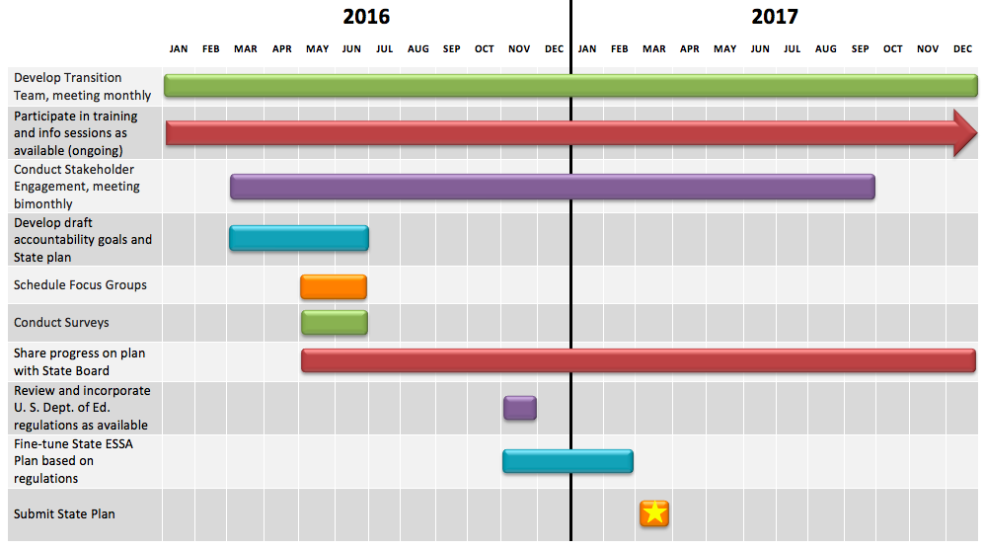
Timeline

Slide 19
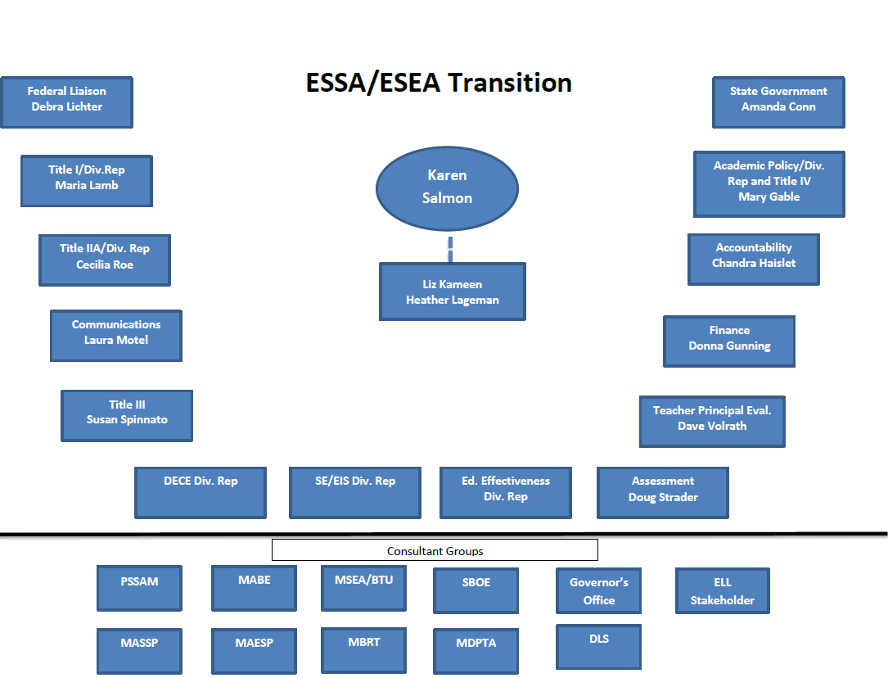
Maryland’s Team

Slide 20
Input
Guiding Questions:
  What comments or questions to you have in the area of Standards and Assessments?
  What comments or questions do you have in the area of Reporting Requirements?
  What comments or questions do you have in the area of Services for Els?
  Are there any other areas of concern/comment?

Slide 21

Questions?

